Slide 1

Insurance Customer Response Prediction
Predicting Customer Interest in Insurance Policy Offers
Notes:
1

Slide 2





Introduction: Why Predict Customer Response?
This project uses machine learning to predict customer interest in insurance policy offers. By understanding key customer behavior patterns, the solution helps insurance companies target the right customers, improve marketing efficiency, and maximize conversion rates. The model integrates data insights, algorithm evaluation, and a deployed Streamlit application for real-time predictions.
Cost Efficiency
Conversion Optimization
Insurance companies face costly, inefficient marketing without targeted outreach strategies
Predicting customer interest helps optimize campaigns and increase conversion rates dramatically
Our Focus
Predicting if customers will respond positively to vehicle insurance policy offers
Notes:
2

Slide 3







Workflow Overview
A systematic approach to building our prediction model
Data Collection & Understanding
Gathering comprehensive customer data and understanding feature relationships
Exploratory Data Analysis
Uncovering patterns, correlations, and insights within the dataset
Data Preprocessing & Feature Engineering
Cleaning data and creating meaningful features for model training
Model Selection & Training
Testing multiple algorithms to find the optimal prediction approach
Model Evaluation & Comparison
Measuring performance metrics and comparing model effectiveness
Deployment via UI
Creating an accessible interface for real-world application
Notes:
3

Slide 4


About the Data
Dataset Overview
381K
Our comprehensive dataset contains 381,109 customer records with over 12 distinct features, providing a robust foundation for predictive modeling.
Customer Records
Key Features
Demographics: Age, Gender, Region_Code
Vehicle Information: Vehicle_Age, Vehicle_Damage
Policy Details: Previously_Insured, Annual_Premium
12
Engagement: Policy_Sales_Channel, Vintage (days as customer)
Others : Driving_Licence
Features
Target Variable: Response (1 = Interested, 0 = Not Interested)
0
Missing Values
Clean, ready-to-use data
Notes:
4

Slide 5

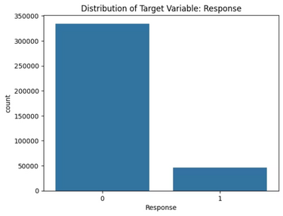
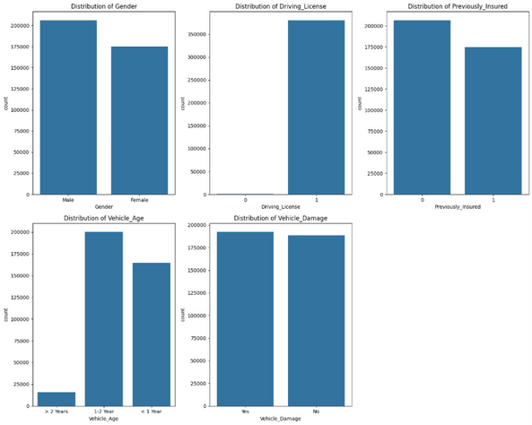
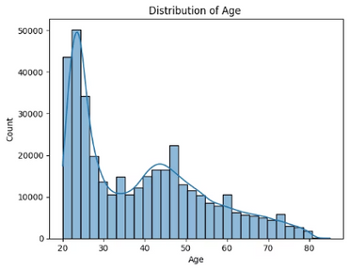
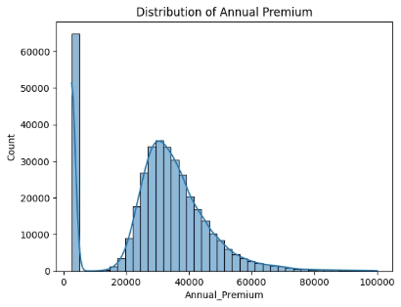
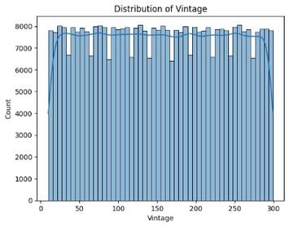
Exploratory Data Analysis Highlights
Target Variable is highly imbalanced
Almost 88% do not response positively.
- and 12% responded positvely.
UNIVARIATE ANALYSIS :
Numeric:
Age: Mostly between 20–50 years; right-skewed with more young customers (20–35).
Annual Premium: Highly right-skewed; majority fall in the ₹20K–50K range.
Vintage: Nearly uniform distribution across 0–300 days, indicating varied customer association duration.
Categorical:
Gender: Slightly more Male customers, but overall balanced.
Driving License: Most customers have DL = 1, making it a low-impact feature.
Previously Insured: Majority are not previously insured—a strong predictor since previously insured customers show lower interest in new policies.
Vehicle Age: Most vehicles are 1–2 years old; few are >2 years. Distinct categories may reflect different renewal/interest behavior.
Notes:
5

Slide 6

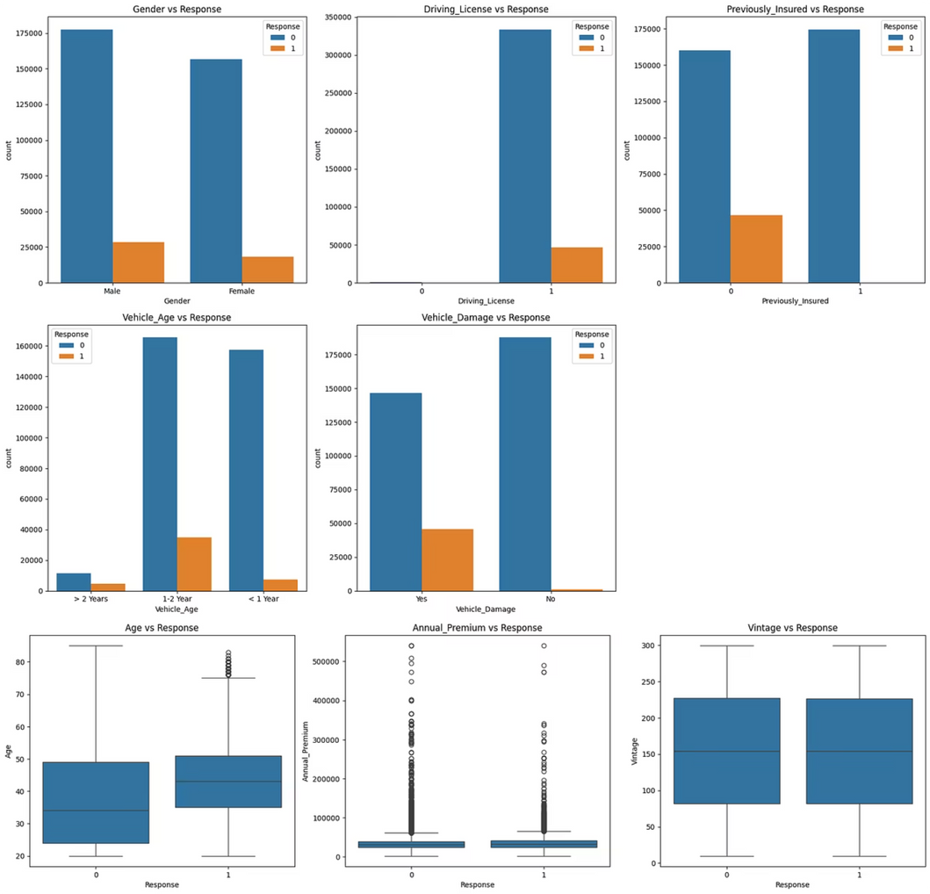
BIVARIATE ANALYSIS :
Gender does not significantly influence customer interest.
Driving License has almost no variability → contributes minimally to prediction.
Previously Insured:
Customers not previously insured (0) show a very high response rate.
Customers previously insured (1) almost never respond.
Vehicle Age:
> 2 Years → highest interest
1–2 Years → moderate interest
< 1 Year → lowest interest
Vehicle Damage:
Customers with Vehicle Damage = Yes respond much more → highly important feature.
Age: Responders tend to be slightly older, though the difference is small.
Annual Premium: Distribution is similar for responders and non-responders → not strongly predictive.
Vintage: Customer tenure shows no meaningful effect on response behavior.
Notes:
6

Slide 7
Data Preprocessing
Dropped the id column
It is only an identifier
Provides no predictive value
Helps reduce noise in the dataset
Encoded Categorical Features
Feature
Original Format
Encoding Applied
Gender
Male/ Female
Male = 0, Female = 1
Vehicle Age
< 1 Year, 1–2 Year, > 2 Years
<1 → 0, 1–2 → 1, >2 → 2
Vehicle Damage
Yes / No
Yes = 1, No = 0
TRAIN TEST SPLIT
→ We divided the data into training (80%) and testing (20%) sets.
→ Setting a random state ensures consistent results and using stratify=y maintains a proportional distribution of the target variable in both sets.
SPLITING THE DATA INTO x & y
→ We divided the dataset into two parts: x and y.
→ "x" typically represents the independent Variables, and "y" represents the Dependent (target variable) that we want to predict or understand.
Notes:
7

Slide 8
Feature Scaling (Standardization)
Why Scaling Was Needed
Numerical features (Age, Annual Premium, Vintage) are on different scales→ e.g., Age ~30, Premium ~30,000
Models like Logistic Regression and even tree ensembles perform better when features are scaled
Ensures fair contribution of each feature to the model.
What Was Done Description :
Step
Description
Selected numeric columns
Age, Annual Premium, Vintage
Fitted StandardScaler on training data only
Prevents data leakage
Transformed training data
Converts values to standardized scale
Applied same scaler to test data
Ensures consistent scaling
Notes:
8

Slide 9

Model Selection & Comparison
Algorithms Evaluated
Top Feature Importance
Logistic Regression
Vehicle Damage → Customers with past vehicle damage show much higher interest.
A simple linear classification model.
Previously Insured → Customers who were not previously insured respond the most.
Assumes a straight-line relationship between features and target.
Useful as a baseline model to compare others against.
Fast, interpretable, but may underperform when data is non-linear.
Vehicle Age → Older vehicles (>2 years) show higher likelihood of response.
Decision Trees
Age → Slight positive influence; responders tend to be slightly older.
A non-linear model that splits data into decision rules.
Easy to visualize and interpret.
Cross-validation (Model Reliability)
Captures feature interactions automatically.
Applied k-fold cross-validation on logistic regression and random forest models.
However, single trees can overfit and may not generalize well.
Random Forest
Ensured the model’s performance is stable, robust, and not overfitting.
An ensemble model of many decision trees.
Achieved consistent ROC-AUC scores, confirming good generalization.
Each tree sees a random subset of data → reduces overfitting.
Handles non-linearity, imbalanced data, and complex patterns very well.
Typically provides higher accuracy and stability than single models.
Notes:
9

Slide 10
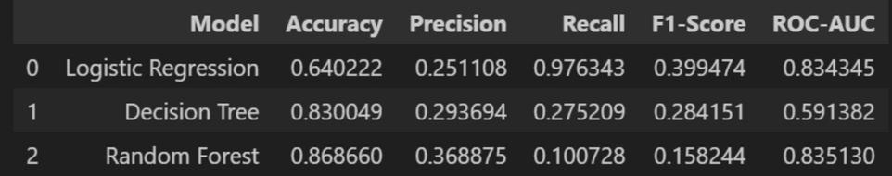



Results & Insights
Tuned Random Forest (Selected Model)
Final Hyperparameters:
n_estimators = 300
max_depth = 20
min_samples_split = 5
Logistic Regression gives highest recall. Random Forest gives highest accuracy but low recall.
min_samples_leaf = 2
class_weight = balanced
threshold = 0.20
Threshold Selection Summary:
Threshold
Recall
Precision
F1
0.10
0.984
0.245
0.392
0.20
0.968
0.262
0.412
0.30
0.930
0.276
0.425
Threshold = 0.20 chosen to maximize Recall while maintaining acceptable Precision.
76%
26%
96%
Model Accuracy
Precision Score
Recall Score
Best performing model on test data
Minimizing false positives
Capturing true positive cases
Notes:
10

Slide 11
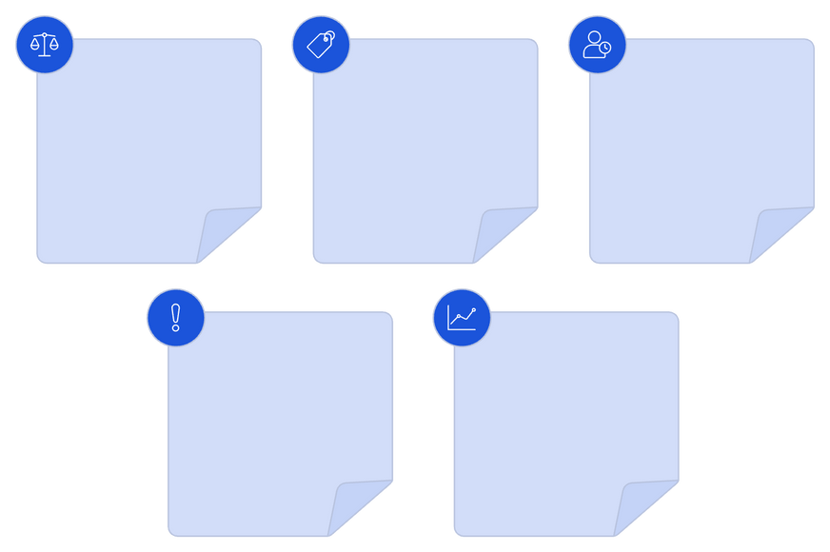





Business Value Delivered
Key Findings
Targeted Marketing: Focus resources on high-probability customers
Customers not previously insured and those with vehicle damage show the highest interest in purchasing insurance.
Cost Reduction: Minimize wasted outreach to uninterested customers
Revenue Uplift: Improve conversion rates through precision targeting
Vehicle Age (>2 years) is a strong indicator of response likelihood.
Strategic Insights: Understand key drivers of customer interest
Logistic Regression achieved high recall, Random Forest achieved high accuracy, butTuned Random Forest (threshold = 0.20) delivered the best balance for business needs.
Limitation
High-recall model ensures maximum customer capture for targeted marketing.
Low-Value Features
Missing Customer Depth
Class Imbalance
Future Research
Only ~12% positive responses
Driving License, Premium, Vintage add little
No income, claims, or communication logs
Add more meaningful features (demographics, past claims, customer interactions).
Experiment with advanced models like XGBoost, LightGBM, CatBoost.
Low Precision Risk
Model Impact
Bias toward majority class expected
Build a real system and integrate model into CRM for real-time targeting.
Higher likelihood of false positives
Notes:
11

Slide 12
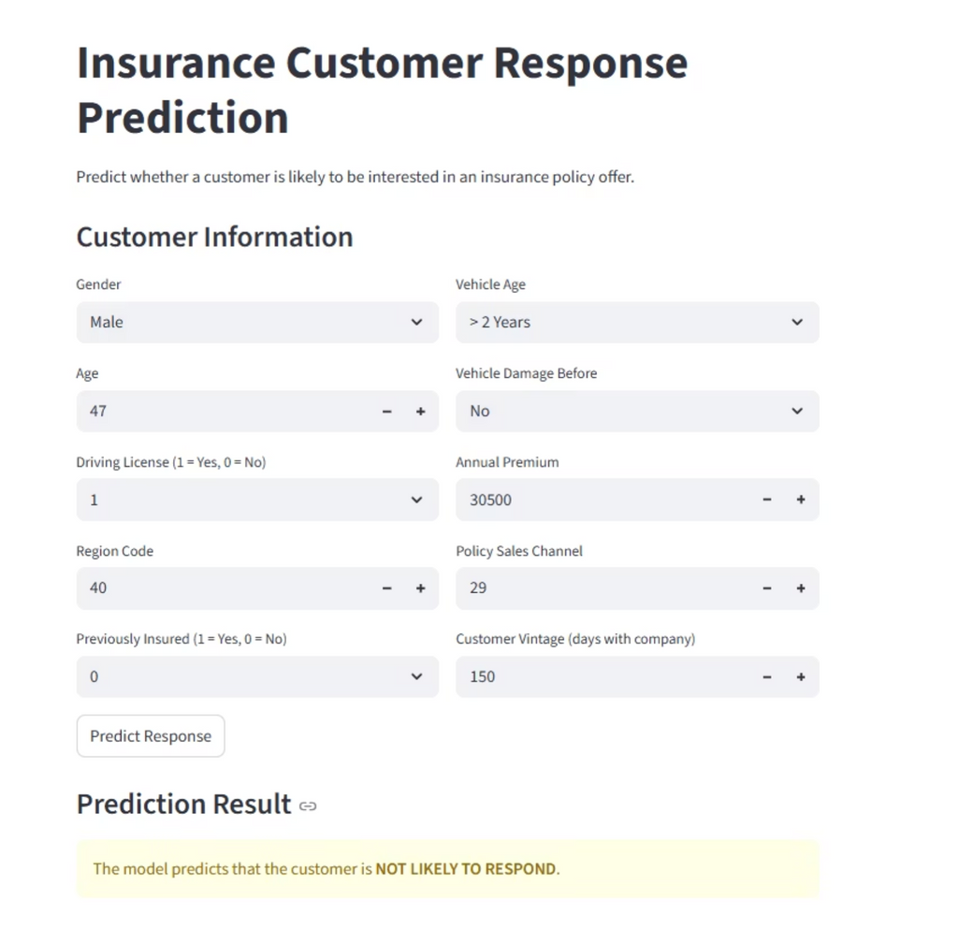
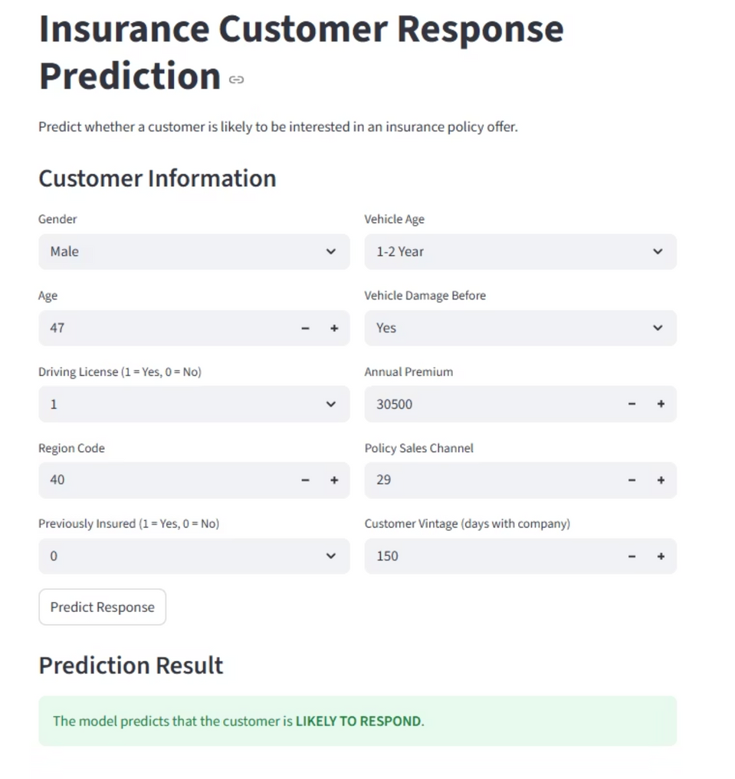
User Interface for Prediction
Notes:
12

Slide 13

Thank You!
Notes:
13

